Slide 1





Course Name object oriented analysis and design
CSC 2210
(Undergraduate)
Software engineering (Undergraduate)
Chapter 7 collaboration diagram
M. Mahmudul hasan
Assistant Professor, CS, AIUB
http://www.dit.hua.gr/~m.hasan

Slide 2
Collaboration diagram
Slide-2
It is also an Interaction diagram
Dynamic behaviour of objects can, in addition to sequence diagrams, also be represented by collaboration diagrams.
The difference between sequence diagrams and collaboration diagrams is that collaboration diagrams emphasize more the structure than the sequence of interactions.
The transformation from a sequence diagram into a collaboration diagram is a bi-directional function
Within sequence diagrams the order of interactions is established by vertical positioning whereas in collaboration diagrams the sequence is given by numbering the interactions.

Slide 3
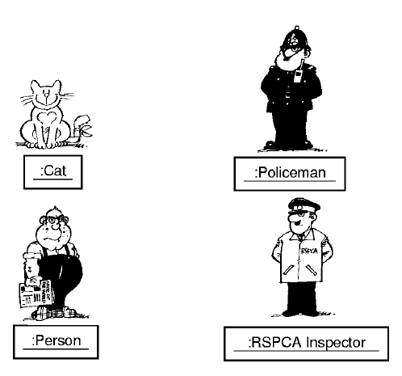
Case scenario
Slide-3
Royal Society for the Prevention of Cruelty to Animals

Slide 4
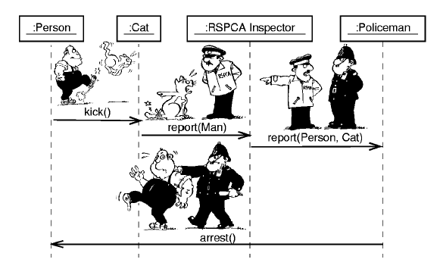
Sequence diagram
Slide-4

Slide 5
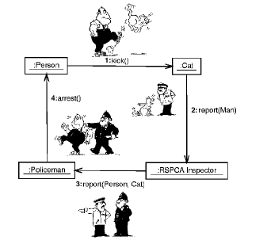
Collaboration diagram
Slide-5

Slide 6
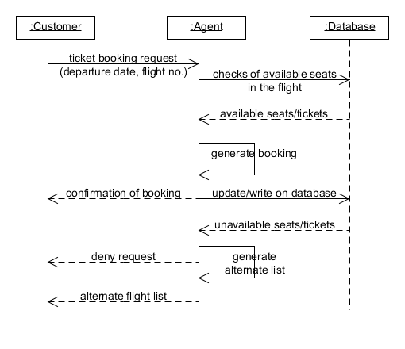
Draw a collaboration Diagram
Slide-6

Slide 7
references
Slide-7
Booch, G., Rumbaugh, J. & Jacobson, I. (2005). The unified modeling language user guide. Pearson Education India.

